Slide 1
AERORESERVE
Guide name : Mr. Dhanabal L
Submitted By,
Srisabarish N(22MCA054)

Slide 2
OBJECTIVES:
Create a sustainable and friendly booking website for passengers.
Provide a detailed descriptions and prices for all type of tickets for passengers.
Enable real-time tracking and monitoring of booking status for passengers and to track flight status for administrators.
Establish Online booking of tickets as a trusted one for the passengers.
Maintain a centralized database of flights and booking tickets, ensuring data security and confidentiality.
Reduce workload for users to book a ticket when they need to travel.

Slide 3
HARDWARE REQUIREMENT:
Processor : 12th Gen Intel(R) Core(TM) i3-1215U 1.20 GHz
Hard Disk : 500 GB
Ram : 8 GB

Slide 4
SOFTWARE REQUIREMENT:
Operating System :Windows 11
Front End : HTML & CSS
Coding Language : Java Script
Back End : MySQL

Slide 5
EXISTING SYSTEM :
The existing system may have limited search options, making it difficult for users to find specific flights based on their preferences.
The existing system may be slow. If the system is not optimized for high traffic or lacks efficient server infrastructure, it may suffer from slow response times.
If the system does not have real-time synchronization with the flight databases of airlines, it may display outdated or incorrect flight information.
If the system does not have a friendly customer support mechanism, passengers may face challenges in booking or resolving issues related to their bookings.

Slide 6
PROPOSED SYSTEM:
The proposed system has an advanced search options, filters, and interactive features, providing users with a more intuitive and user-friendly experience.
The proposed system addresses the issue of slow response times by optimizing the system's performance and provides an efficient server infrastructure.
By accessing with airline databases and using real-time synchronization, the proposed system ensures that flight information is accurate and up to date.
The proposed system integrates with multiple payment gateways, offering users a wide range of payment options.
Comprehensive reporting and analytics for continuous improvement.

Slide 7
MODULES:
Admin Module

Slide 8
User Module

Slide 9
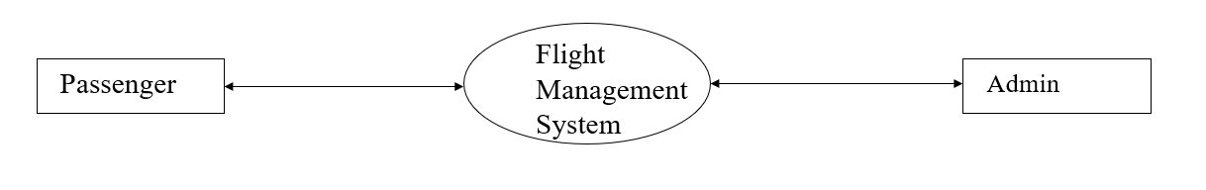
Data Flow Diagram
Level 0

Slide 10
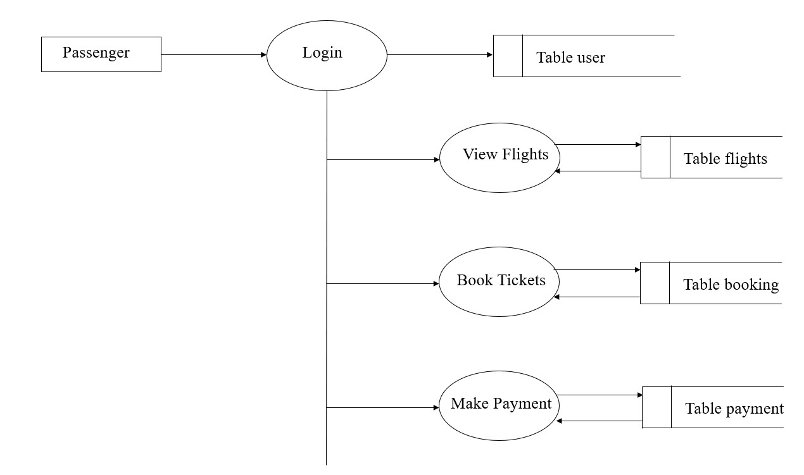
Level 1

Slide 11
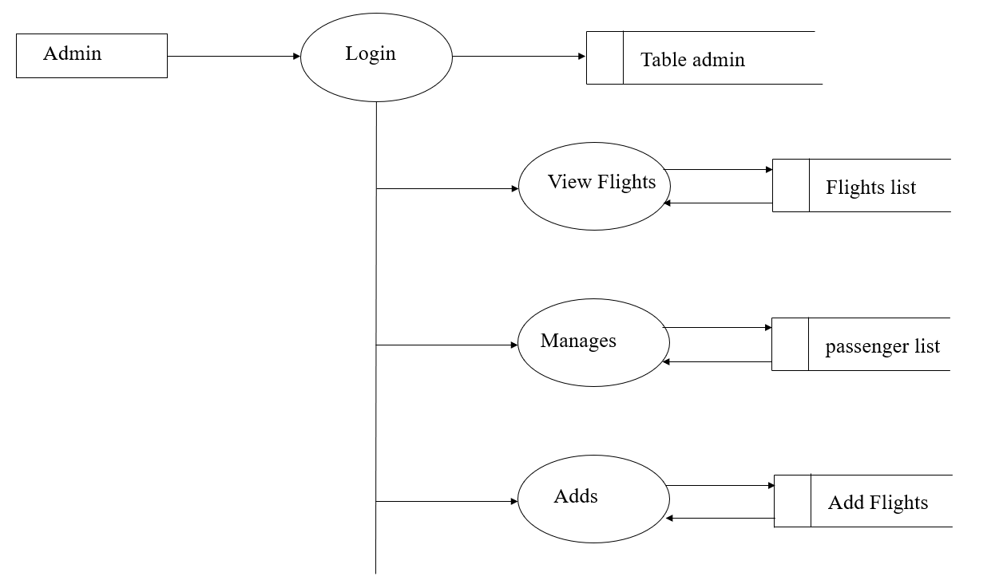
Level 1(Contd..)

Slide 12
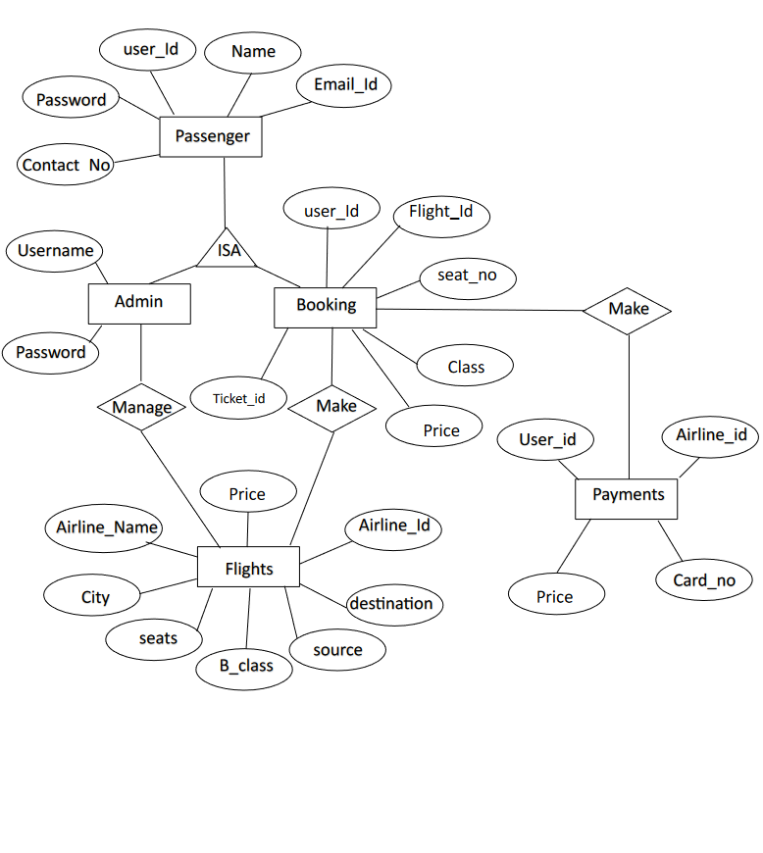
ER Diagram

Slide 13
TABLE DESIGN:
Admin table Primary key: Admin id
S.no | Column Name | Datatype | Description | Constraint
1 | admin_id | int(11) | Id to login for the admin | Not Null
2 | admin_uname | varchar(20) | Name for the admin to login | Not Null
3 | admin_email | varchar(50) | Email id | Not Null
4 | admin_pwd | varchar(100) | password | Not Null

Slide 14
User table Primary key: user id
S.no | Column Name | Datatype | Description | Constraint
1 | user_id | int(11) | Id to login for the user | Not Null
2 | user_uname | varchar(20) | Name for the admin to user | Not Null
3 | user_email | varchar(50) | Email id | Not Null
4 | user_pwd | varchar(100) | password | Not Null
Airline table Primary key: airline_id
S.no | Name | Type | Description | Constraint
1 | airline _id | Int(11) | Airline’s ID | Not Null
2 | Name | Varchar(20) | Name of the Flight | Not Null
3 | Seats | Int(11) | Number of Seats | Not Null

Slide 15
Flight table Primary key: flight id
S.no | Name | Type | Description | Constraint
1 | flight_id | int(11) | Flight id | Not Null
2 | admin_id | int(11) | Admin id | Not Null
3 | arrival | datetime | Arrival time of flight | Not Null
4 | departure | datetime | departure time of flight | Not Null
5 | Destination | varchar(20) | Destination place | Not Null
6 | source | varchar(20) | Source place | Not Null
7 | Price | int(11) | Price of ticket | Not Null

Slide 16
Booking table Primary key: ticket id
S.no | Name | Type | Description | Constraint
1 | ticket_id | int(11) | Ticket id | Not Null
2 | passenger_id | int(11) | Passenger id | Not Null
3 | flight_id | int(11) | Flight id | Not Null
4 | user_id | int(11) | User id | Not Null
5 | seat_no | varchar(10) | Seat no after booking | Not Null
6 | cost | int(11) | price | Not Null
7 | class | varchar(10) | Type of class | Not Null

Slide 17
Payment table Primary key: Card no
S.no | Name | Type | Description | Constraint
1 | Card_no | Varchar(16) | Card details | Not Null
2 | User_id | Int(11) | User’s id | Not Null
3 | Flight_id | Int(11) | Flight Id | Not Null
4 | Expire Date | Varchar(5) | Expiring Date of the card | Not Null
5 | amount | Int(11) | Price for the ticket | Not Null
City table
S.no | Name | Type | Description | Constraint
1 | City | Varchar(20) | City Names | Not Null

Slide 18
OUTCOME OF THE PROJECT:
The outcome of the online flight booking system project is a user-friendly platform enabling travelers to effortlessly search for flights and securely book tickets, thus streamlining the booking process and enhancing overall travel experience.

Slide 19
References:
“Flight Management Systems: The Evolution of Avionics and Navigation Technology” by Samuel B. Fishbein
“Flight Management Systems” by Randy Walter

Slide 20
THANK YOU

